Slide 1
Following the Star
THE TRAIL · NEW TESTAMENT EDITION
Matthew 2:1–12
Notes:
Title slide. Use it for the first slide of a set, or a series opener. Readers see slides on a phone, so keep words few and large. Body text 24pt or more. Export: File > Export > Images (or PDF), then add them to this day on the admin page.

Slide 2
Following the star
DAY 3
Matthew 2:1–12
Notes:
Day opener: day number, the day's title, and the reading.

Slide 3
“Where is the child who has been born king of the Jews? For we observed his star at its rising, and have come to pay him homage.”
Matthew 2:2
NRSV
Notes:
Scripture slide. Paste the verse from Bible Gateway and check the wording. Keep it to one or two verses so the text stays large.

Slide 4
Three responses to the news
The magi travel far, kneel, and give
The scholars know the answer and stay home
Herod hears it as a threat
Notes:
Points slide. Three or four short points at most. Readers see slides on a phone, so keep words few and large. Body text 24pt or more. Export: File > Export > Images (or PDF), then add them to this day on the admin page.

Slide 5
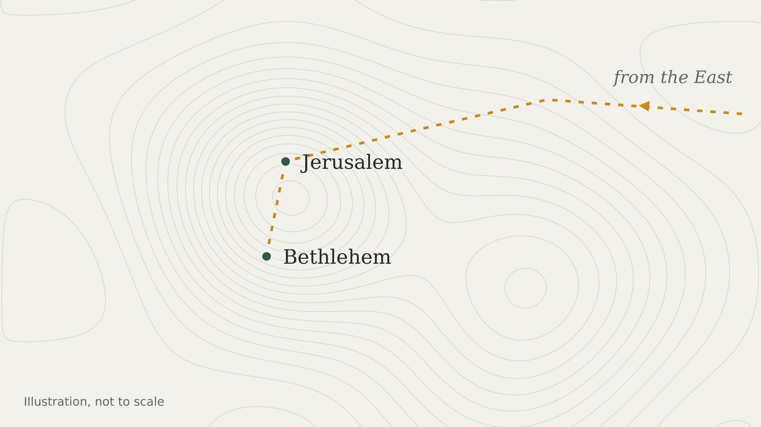
The road to Bethlehem
Notes:
Picture slide for a map, photo, or diagram. Click the picture, then use Replace Picture (PowerPoint) or drag a new image onto it (Keynote). Make sure you have the rights to any image you use.

Slide 6
Two kinds of seekers
Herod
The magi
Hears the news
Calls a meeting
Plans to protect himself
Follow the star
Kneel and give gifts
Go home by another road
Notes:
Compare slide: two sides of a contrast, three points each.

Slide 7
Matthew 1–2 at a glance
Family line
Joseph’s dream
The magi
Flight to Egypt
Home to Nazareth
1:1–17
1:18–25
2:1–12
2:13–15
2:19–23
Notes:
Timeline slide. The gold marker shows where today's reading sits. Duplicate or delete a marker group (marker, name, reference) to change the number of stops, then even out the spacing.

Slide 8
TALK IT OVER
Where might God be asking you to take another road?
Notes:
Question slide for small groups. One question per slide.

